Slide 1



Uncovering Patterns
in Student Work
Machine learning to understand human learning
Dissertation Defense:
Chris Piech
Advisors: Leonidas Guibas
and Mehran Sahami

Slide 2


Four Prototypical Trajectories
Imagine your brain

Slide 3
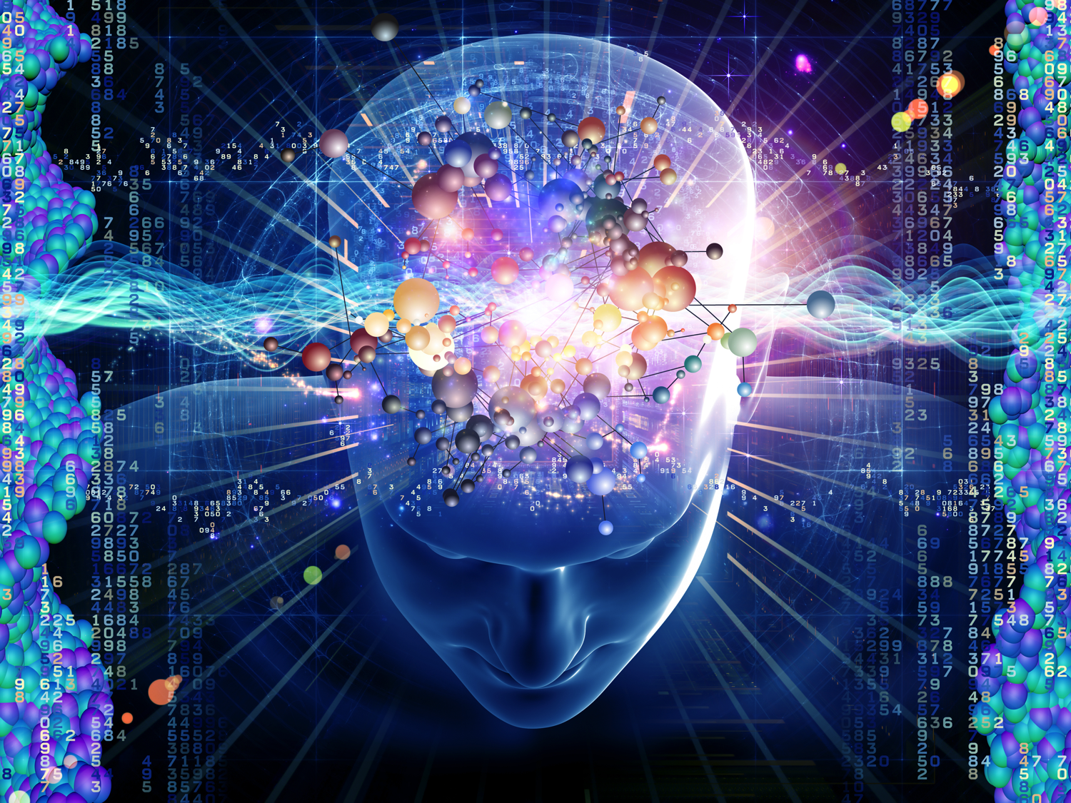

Slide 4
Four Prototypical Trajectories
How would you model your brain learning?

Slide 5
Grand Challenge in Education
Clear
Societal Need
Grand Challenge
in Education
Increase
education
productivity
Autonomously support teachers. Can we
understand individual learning and provide
quality feedback for students as they work
on assignments?
MOOC
assignments
Neural
networks
New
Datasets of
Learning
New Machine
Learning
Education debt > Consumer debt

Slide 6

Shortage of Quality Education
90% of children enroll in primary education [1]
40% in secondary education [1]
20% in tertiary education [1]
Dramatic quality differences
Education debt > Consumer debt
[1] World development indicators 2015. World Bank Publications, 2015.

Slide 7
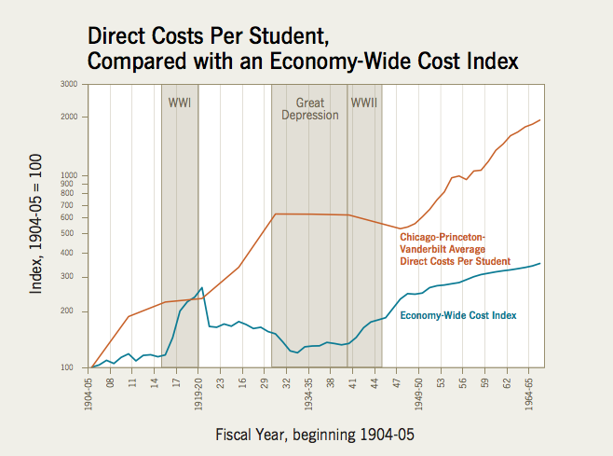
Cost Disease of Education
Give quality feedback to complex assignments.
Education debt > Consumer debt
William G Bowen. The cost disease in higher education: Is technology the answer. 2012.

Slide 8
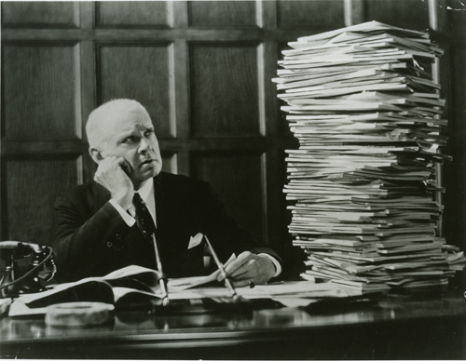

Feedback is Labor Intensive
Online classes hasn’t solved the feedback problem.
Notes:
Andrew NG can’t grade all 1 million assignments, but he can afford to grade 500. The crux of the problem is to decide if two programs deserve the same feedback. If they do, and we have given feedback to one program, we can simply copy and paste that feedback. This can be posed as a supervised learning problem.

Slide 9

Hard Problem
Students forget
Short term and long term memory
Transfer knowledge (complex)
Zone of proximal development
Individual differences

Slide 10






Unprecedented Data
Over 50 million learners

Slide 11
US K-12 Students
= 500,000 learners

Slide 12
Code.org Students
= 500,000 learners

Slide 13

Feedback at Scale is a Grand Challenge
[paintinghere.com]
Notes:
I would like to start by taking a moment to appreciate Beautiful assignments. And when I say Beautiful Im thinking you know the capital B.
really engaging with.
Make something that they are proud of,
go way above and beyond.
show their mom,
maybe that exposes them to the best part of working in your discipline and hopefully something that changes their identity
The sort of assignment that you give to students and you tell them “your going to love this.”… and their like “well actually, Chris, I was planning on going on a hike with my friends….”
Beautiful with a captal B. The good stuff in school

Slide 14
Feedback at Scale is a Grand Challenge
Spectrum of Assignmnt Complexity

Slide 15
Feedback at Scale is a Grand Challenge
Design a Product
Programs
Write a Poem
Multiple Choice
Math Proofs
Short Answer

Slide 16
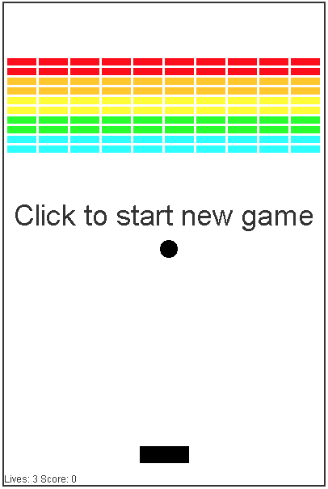
Feedback at Scale is a Grand Challenge
Design a Product
Programs
Write a Poem
Multiple Choice
Math Proofs
Short Answer

Slide 17
Especially Inefficient for CS
Projected # jobs in computing
Projected # CS Students

Slide 18


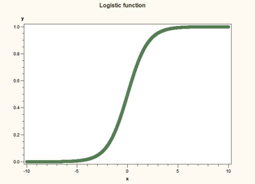
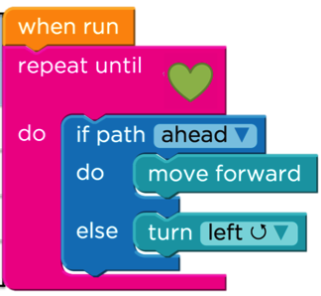

Datasets (1/2)
Machine Learning
Machine Learning
Hour of Code
CS106A
20K Students
20 Assignments
Submissions
1.2M Students
20 Assignments
Full trajectories
3K Students
15 Assignments
Full trajectories

Slide 19


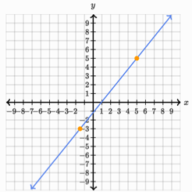
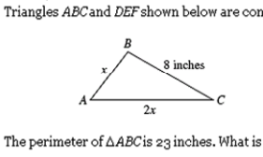
Datasets (2/2)
Eighth Grade
Common Core
Human Computer
Interaction
120K Students
70 Question Types
Full trajectories
16K Students
124 Question Types
Full Trajectories

Slide 20






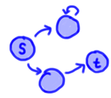
Zipf’s Law
Assignment A
Assignment B
Assignment C
Assignment D
Percent of Submissions
s = 1.42
s = 1.82
s = 2.14
s = 2.67
Submission Rank Index
int func(int a,
return a +
}
Correct /
Incorrect
Maze
Programming
Control
Flow
General
Programming

Slide 21
Progress
Understanding Curriculum Navigation
Understanding Problem
Navigation
Understanding Solution
Space
Peer
Grading
Correct/
Incorrect
Maze
Programs
Control Flow Programs
General Programs

Slide 22







Progress
Understanding Curriculum Navigation
1
Understanding Problem
Navigation
2
Understanding Solution
Space
3
3
3
Peer
Grading
Correct/
Incorrect
Maze
Programs
Control Flow Programs
General Programs

Slide 23

[Kid President]

Slide 24
We could give feedback to programming assignments at scale
[Kid President]

Slide 25
Decompose The Problem
Machine Learning
Component
Education
Component

Slide 26


Thesis Route
Thesis
Space
Temporal
Curricula
Challenge

Slide 27
Thesis Route
Thesis
Space
Temporal
Curricula
Challenge

Slide 28
Four Prototypical Trajectories
How do Students Learn Across Curricula?

Slide 29
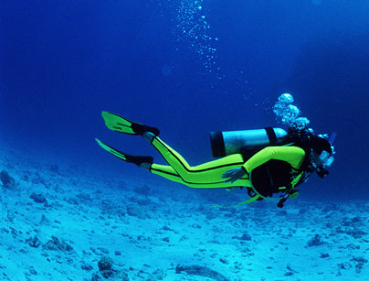
Deep Knowledge Tracing

Slide 30



Knowledge Tracing
Given n historical answers:
…
Answer is a tuple:
Predict the next one
Question id
Correct or not

Slide 31

Old Problem
First posed in 1993
Education debt > Consumer debt

Slide 32
Limits of the State of the Art
Needs fine grained concept labels
No way to model correspondences between concepts
Can only handle correct/incorrect questions
Addressed by Deep Knowledge Tracing
Discrete representation is unrealistic
Can’t incorporate long term interactions

Slide 33
Four Prototypical Trajectories
Lets look to another domain

Slide 34
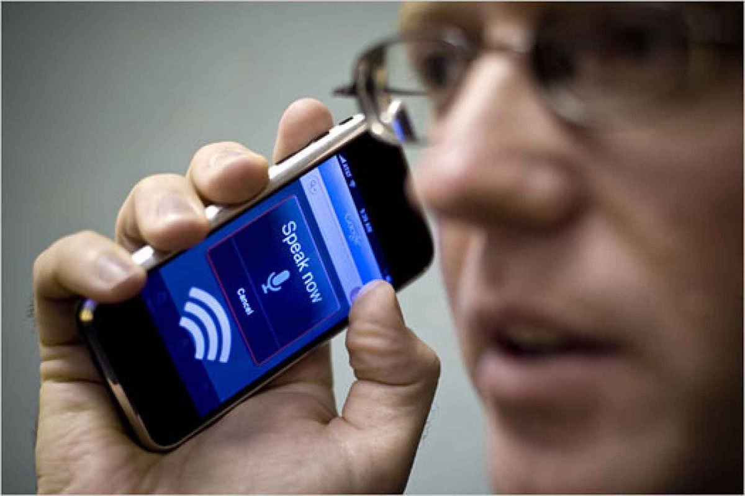
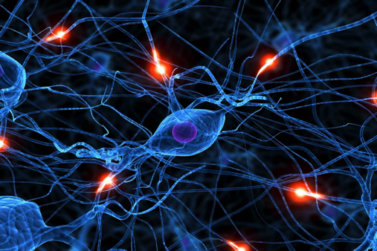
Speech Recognition

Slide 35
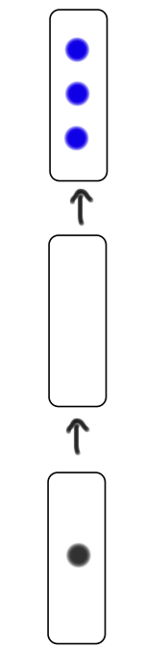
Deep Knowledge Tracing
y
h
x

Slide 36
Deep Knowledge Tracing
y
Prediction of future student interaction
A vector which represents underlying “neurons”
h
x
Vector encoding of student interaction

Slide 37

Deep Knowledge Tracing
h₀

Slide 38
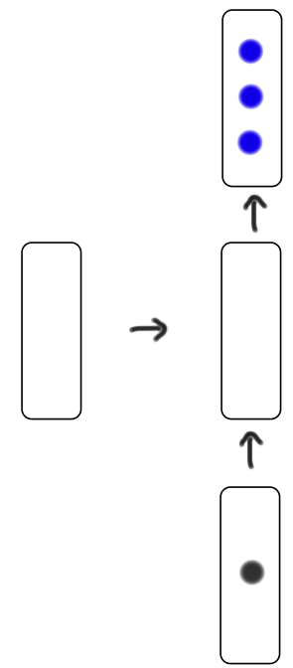
Deep Knowledge Tracing
y₁
h₀
h₁
x₁

Slide 39
Deep Knowledge Tracing
y₁
h₀
h₁
x₁

Slide 40
Deep Knowledge Tracing
y₁
h₀
h₁
x₁

Slide 41
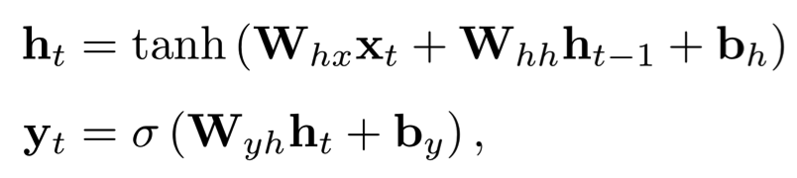
Deep Knowledge Tracing
y₁
h₀
h₁
x₁

Slide 42
Deep Knowledge Tracing
y₁
h₀
h₁
x₁

Slide 43
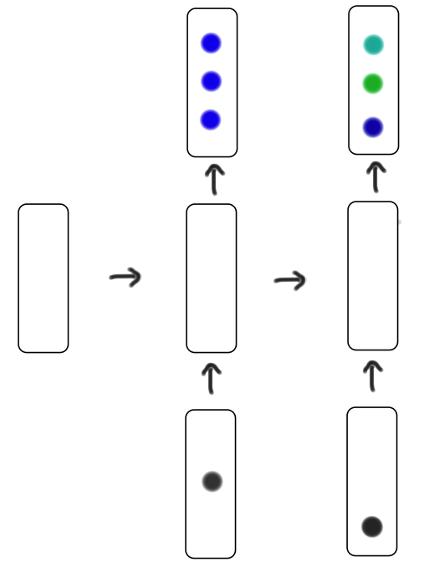
Deep Knowledge Tracing
y₁
y₂
h₀
h₁
h₂
x₁
x₂

Slide 44
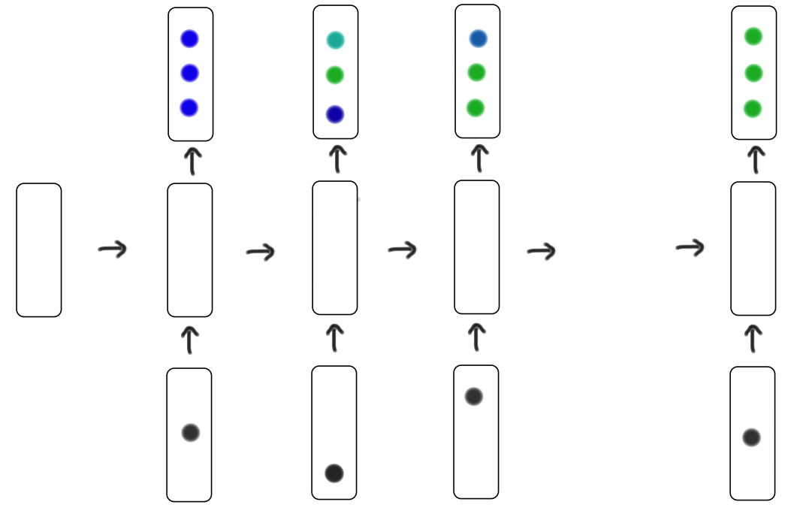
Deep Knowledge Tracing
y₁
y₂
y₃
y_{T}
…
h₀
h₁
h₂
h₃
h_{T}
x₁
x₂
x₃
x_{T}

Slide 45

How to represent action?
Answer is a tuple:
One-hot
encoding of (question, answer) tuple
Question id
Correct or not
N = 2 x |questions|

Slide 46
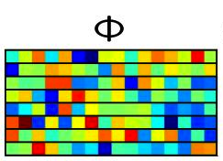

Compressed Sensing
M x 1
One-hot
encoding
New Input
Vector
=
N x 1
Random Matrix
M x N
M can be around log(N) with good results

Slide 47
Four Prototypical Trajectories
Results?

Slide 48
Four Prototypical Trajectories
[suspense]

Slide 49
Four Prototypical Trajectories
Synthetic Data

Slide 50
Item Response Theory Data
Oracle

Slide 51
Item Response Theory Data
Oracle
State of the Art

Slide 52
Item Response Theory Data
Oracle
Our Methods
State of the Art

Slide 53
Item Response Theory Data
Oracle
Our Methods
Works without expert concept labels!
State of the Art

Slide 54
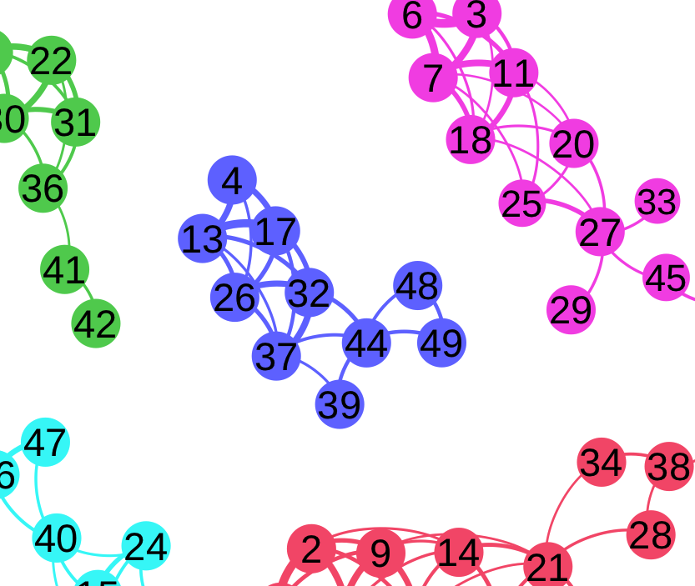
Learns Concepts

Slide 55
Learns Concepts
Notice the length in time!

Slide 56



Datasets
47 thousand students
16 thousand students
4 thousand students
69 question tags
124 question tags
50 question tags

Slide 57
Four Prototypical Trajectories
Real Data

Slide 58

Prediction Results
RNN vs LSTM didn’t matter too much
Huge improvement in ability to predict for real students

Slide 59
Learns Concept Relationships
Scatter plots
Pythagorean
theorem
Lines
Angles
Functions
Exponents
Systems of
Equations
Line graphs
Fractions

Slide 60
Learns Concept Relationships

Slide 61
Learns Concept Relationships
Finding the x-intercept

Slide 62
Learns Concept Relationships
Finding the y-intercept

Slide 63
Learns Concept Relationships
Slope of a line

Slide 64
Learns Concept Relationships
Graphing
Linear Equations

Slide 65
Learns Concept Relationships
Graphing
Systems of Equations

Slide 66
Just Transitions?
No!

Slide 67
Just Conditional Probabilities?
No!

Slide 68
Learns Concept Relationships
Scatter plots
Pythagorean
theorem
Lines
Angles
Functions
Model can demonstrate convincing binary relationships
Exponents
Systems of
Equations
Line graphs
Fractions

Slide 69
Four Prototypical Trajectories
Optimal Curriculum

Slide 70
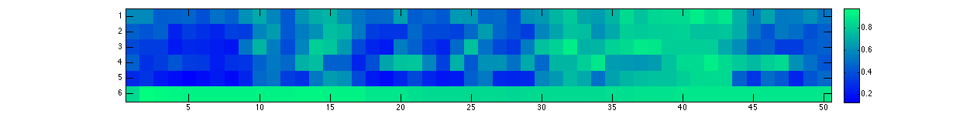
Predicting Next Item
Exercise attempted: correct, incorrect
1.0
Predicted Probability
0.5
10
20
30
40
50
0.0
Exercise index
Line graph intuition
Slope of a line
Solving for x-intercept
Solving for y-intercept
Graphing linear equations
Square roots

Slide 71
Predicting Next Item
Exercise attempted: correct, incorrect
1.0
Predicted Probability
0.5
10
20
30
40
50
0.0
Exercise index
Line graph intuition
Slope of a line
Solving for x-intercept
Solving for y-intercept
Graphing linear equations
Square roots

Slide 72
Predicting Next Item
Exercise attempted: correct, incorrect
1.0
Predicted Probability
0.5
10
20
30
40
50
0.0
Exercise index
Line graph intuition
Slope of a line
Solving for x-intercept
Solving for y-intercept
Graphing linear equations
Square roots

Slide 73
Predicting Next Item
Exercise attempted: correct, incorrect
1.0
Predicted Probability
0.5
10
20
30
40
50
0.0
Exercise index
Line graph intuition
Slope of a line
Solving for x-intercept
Solving for y-intercept
Graphing linear equations
Square roots

Slide 74
Predicting Next Item
Exercise attempted: correct, incorrect
1.0
Predicted Probability
0.5
10
20
30
40
50
0.0
Exercise index
Line graph intuition
Slope of a line
Solving for x-intercept
Solving for y-intercept
Graphing linear equations
Square roots

Slide 75
Predicting Next Item
Exercise attempted: correct, incorrect
1.0
Predicted Probability
0.5
10
20
30
40
50
0.0
Exercise index
Line graph intuition
Slope of a line
Solving for x-intercept
Solving for y-intercept
Graphing linear equations
Square roots

Slide 76
Predicting Next Item
Exercise attempted: correct, incorrect
1.0
Predicted Probability
0.5
10
20
30
40
50
0.0
Exercise index
Line graph intuition
Slope of a line
Solving for x-intercept
Solving for y-intercept
Graphing linear equations
Square roots

Slide 77
Predicting Next Item
Exercise attempted: correct, incorrect
1.0
Predicted Probability
0.5
10
20
30
40
50
E[p]
0.0
Exercise index
Line graph intuition
We can find what is the “deal maker”
Slope of a line
Solving for x-intercept
Solving for y-intercept
Graphing linear equations
Square roots

Slide 78
Optimal Curriculum

Slide 79
Optimal Curriculum
Maximize knowledge after 30 questions

Slide 80
Optimal Curriculum
Maximize knowledge after 30 questions

Slide 81
Optimal Curriculum
Maximize knowledge after 30 questions
Model makes optimal curriculum learning more possible.
MDP-8 is intractable in real time.

Slide 82


Overview
Contributions
Limitations
State of the art (on two classic large datasets).
Trains overnight for
47K students
Does not need “concept” labels.
Will it work on small
datasets?
Can express graph of concept interactions.
High dimensional knowledge
representation.
Enables optimal teaching
curricula.
Potential to trace knowledge
beyond correct/incorrect.

Slide 83
Four Prototypical Trajectories

Slide 84
Thesis Route
Thesis
Space
Temporal
Curricula
Challenge

Slide 85
Thesis Route
Thesis
Space
Temporal
Curricula
Challenge

Slide 86

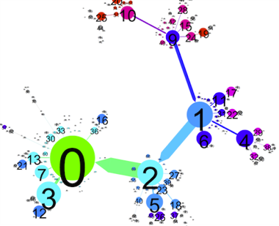
Autonomously Generating Hints by Inferring Problem Solving Policies

Slide 87

Dataset

Slide 88

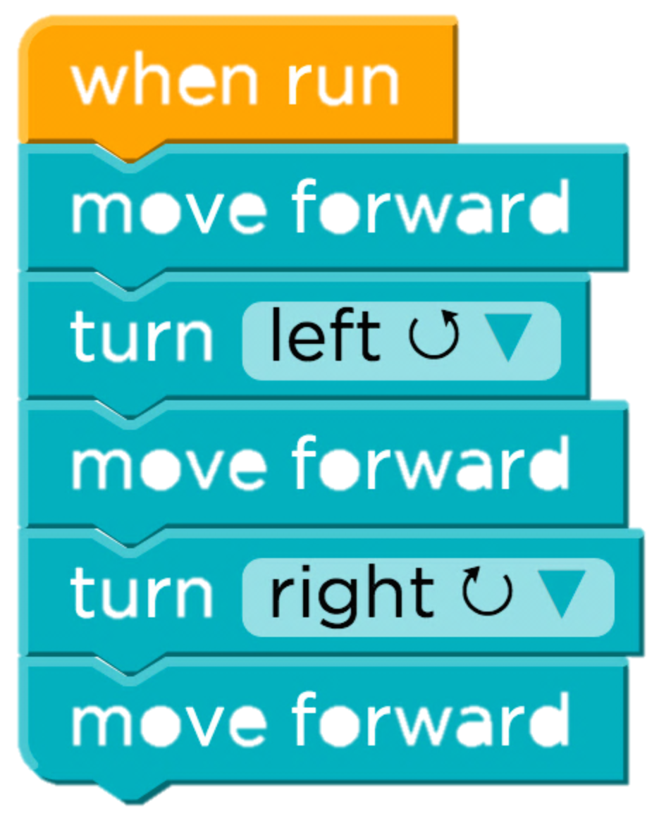
Simple
Easy Problem
Problem A
Ten thousand unique solutions
[copyright Angry Birds]

Slide 89
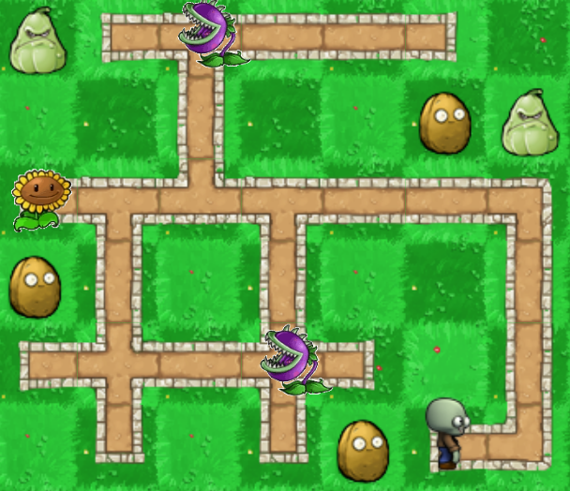
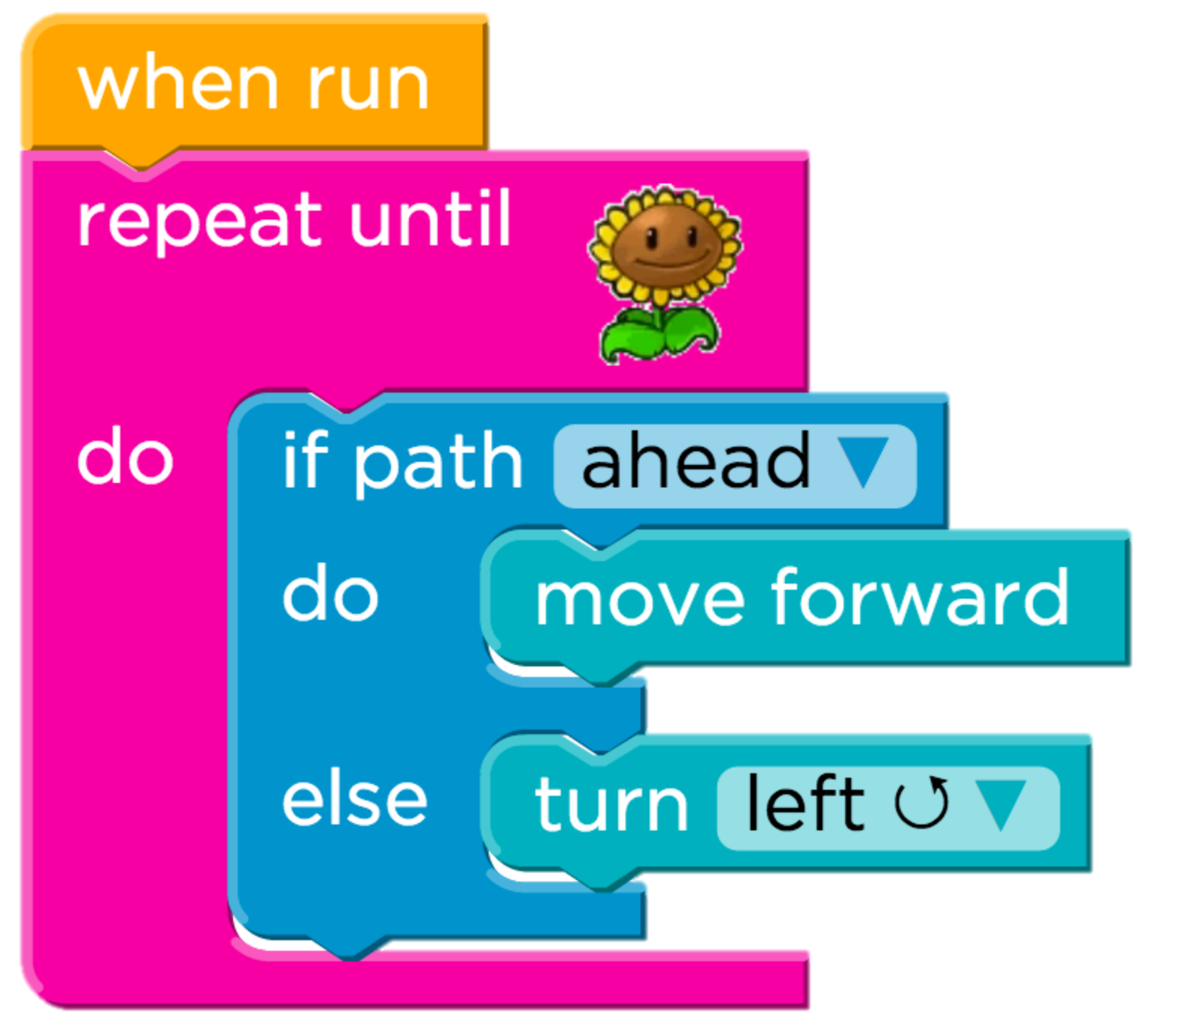
Hard Problem
Problem B
Almost a hundred thousand unique solutions

Slide 90
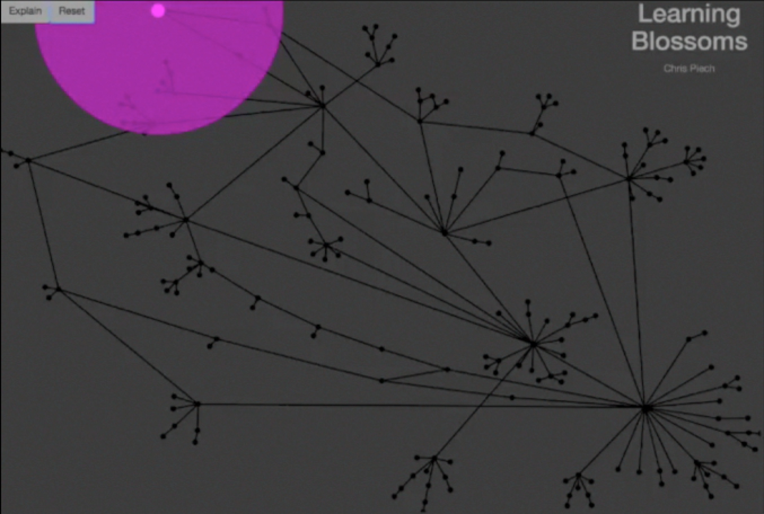

Slide 91
Each edge is what a teacher suggested
Pink dots are students.
Each node is a unique partial solution
Solution

Slide 92
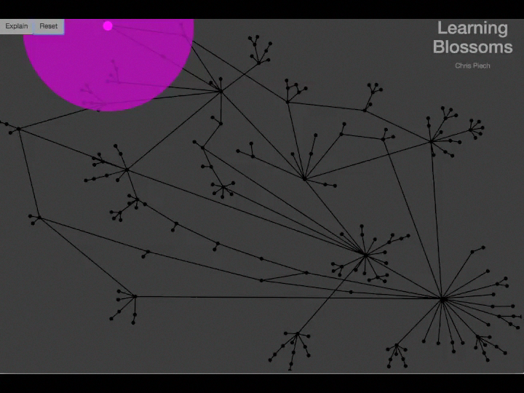

Slide 93
Demographics
Obama
N: 253,500
Age Range: [5, 105]
Mode Age: 13

Slide 94
Machine Learning Problem
solution
Unique submissions

Slide 95
Problem Solving Policy
Machine Learning Problem
solution
Teacher “Policy”

Slide 96
Example Student
solution
Student 1

Slide 97
Example Student
solution
Student 2

Slide 98
Example Student
solution
Student 1,203,403

Slide 99
Machine Learning Problem
solution
Teacher “Policy”

Slide 100
Most Ideas Don’t Work
Easiest Problem
Hardest Problem
86.3%
8.2%
47.6%
4.3%
State of the Art
Desirable Path Algorithms

Slide 101

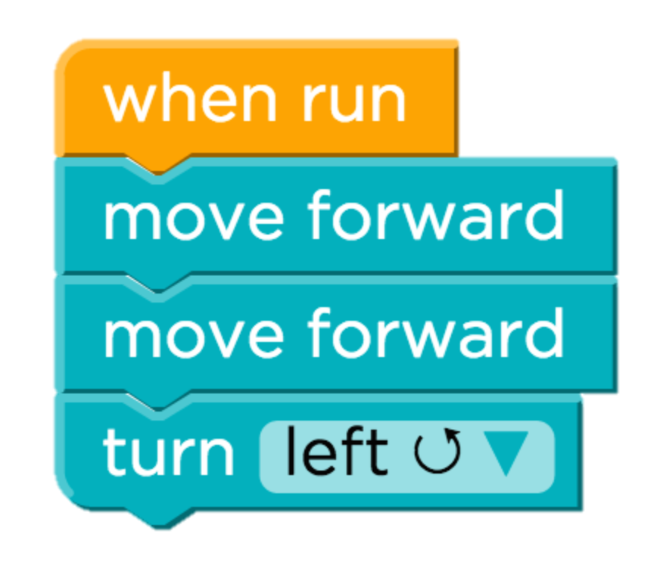
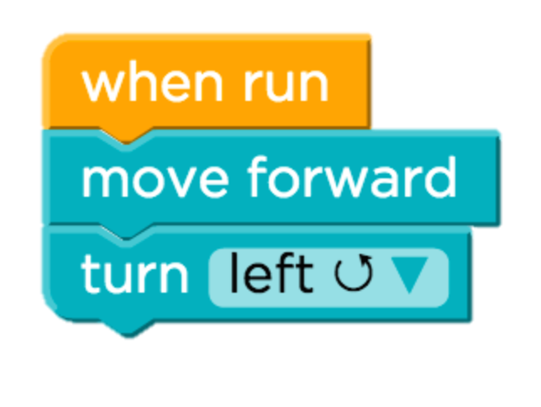
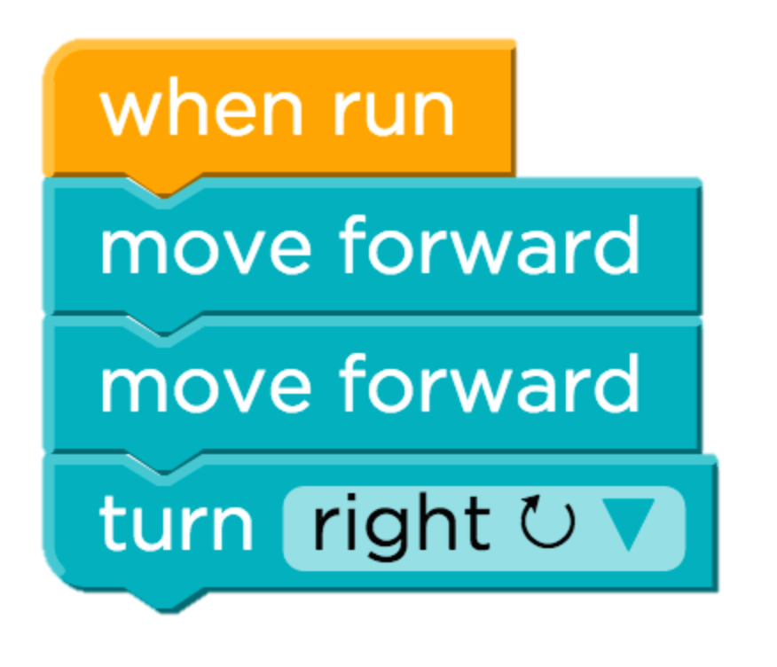
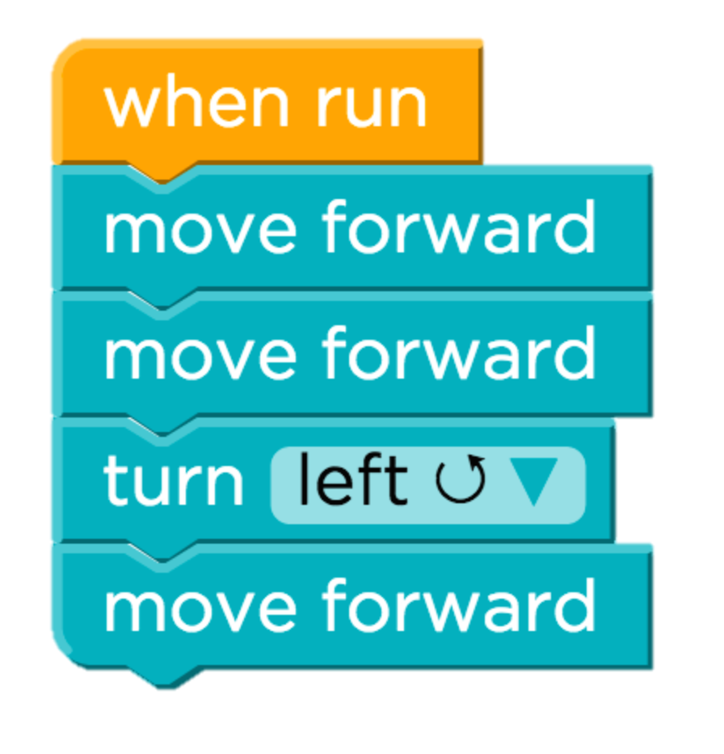
The Crowd is Un-wise
18%
45%
12%
Notes:
Fix this so that its more obvious what is happening.

Slide 102
The Crowd is Un-wise
In 52% of partial solutions the mode next disagrees with experts
Can’t trust wisdom of students that went wrong.

Slide 103
How Can We Hallucinate Average Students?
Imagine Average Students
The number of times a partial solution is submitted is a signal of how desirable that partial solution was to the average student.

Slide 104
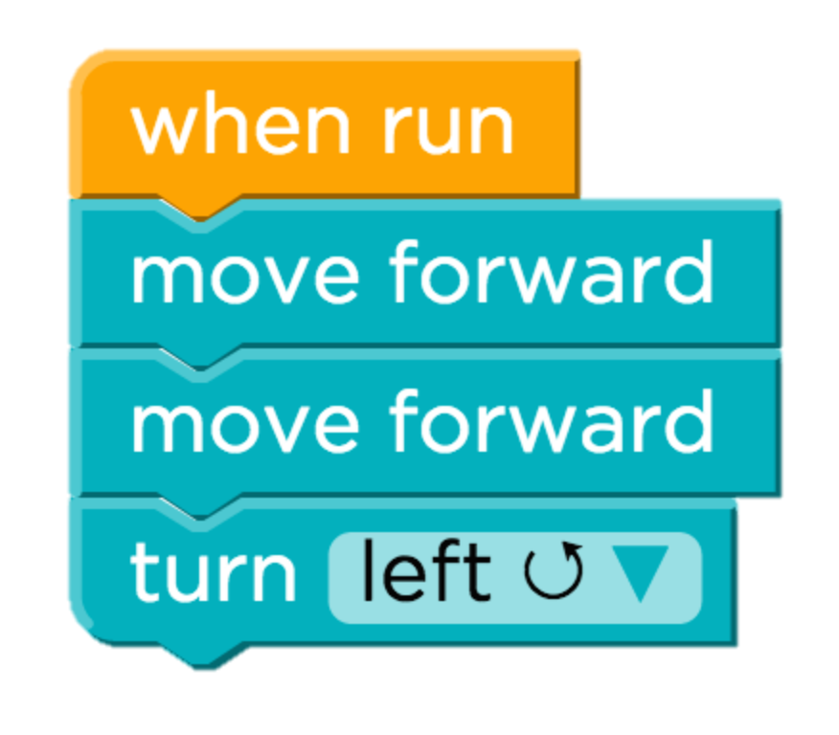
Desirable Path Algorithm

Slide 105
Desirable Path Algorithm
Average student drawn from the class

Slide 106
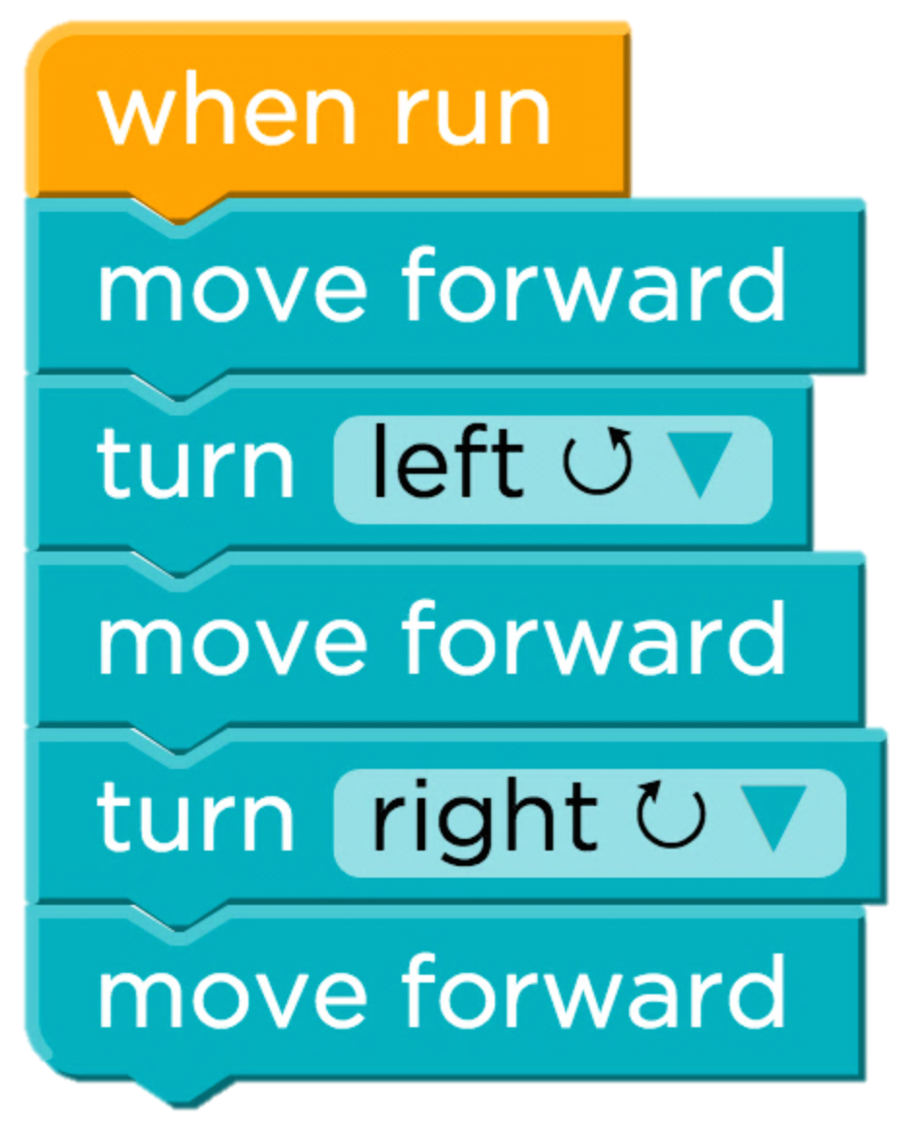
Desirable Path Algorithm

Slide 107
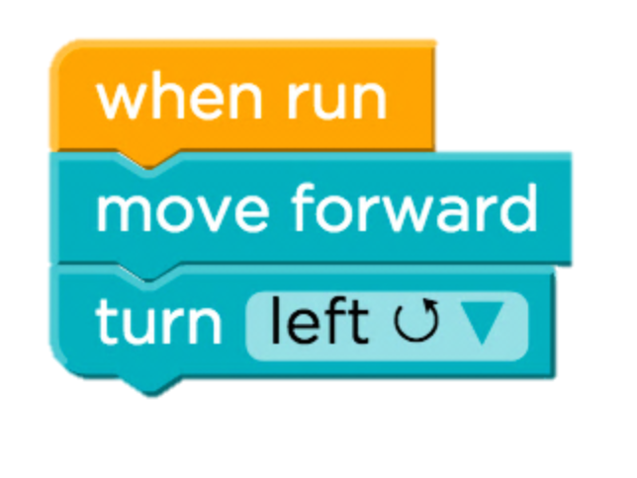
Desirable Path Algorithm
…

Slide 108
Desirable Path Algorithm
…

Slide 109
Warning: Math

Slide 110
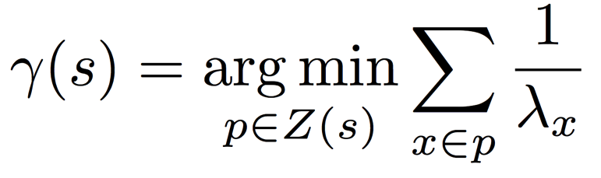
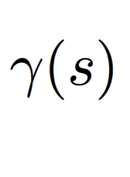
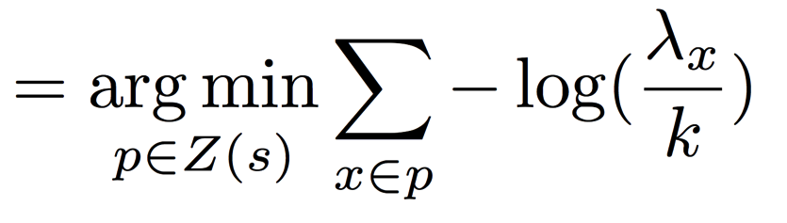
Desirable Path Algorithms
Poisson Common Path
First step in the most frequent path to the solution from s, taken by average students. Assume poison process.
Predicted next partial solution
Independent Probable Path
First step in the most likely path to the solution from s, taken by an average student. Assume markov process.
Total number of submissions
Notes:
Two algorithms
Both theoretically approximate what an average student would do from a state.
Both are closed form.
Look kinda similar ☺.

Slide 111
Desirable Path Algorithms
Poisson Common Path
Path Cost
Submission count of partial solution
Predicted next partial solution
Partial solutions in the path
Paths to solution
Count of partial solution
Independent Probable Path
Total number of submissions
Notes:
Two algorithms
Both theoretically approximate what an average student would do from a state.
Both are closed form.
Look kinda similar ☺.

Slide 112
Desirable Path Algorithms
Poisson Common Path
Path Cost
Submission count of partial solution
Predicted next partial solution
Partial solutions in the path
Paths to solution
Notes:
Two algorithms
Both theoretically approximate what an average student would do from a state.
Both are closed form.
Look kinda similar ☺.

Slide 113
Math Over

Slide 114
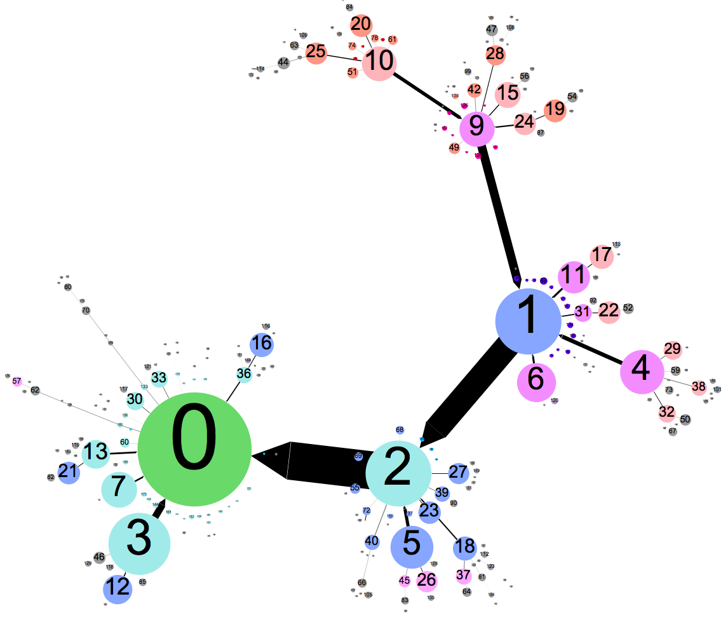
Learned Problem Solving Policy
“Backbone”
Solution

Slide 115
Most Ideas Don’t Work
Easiest Problem
Hardest Problem
86.3%
8.2%
47.6%
4.3%
State of the Art
Desirable Path Algorithms

Slide 116
Desirable Path Algorithms
Easiest Problem
Hardest Problem
95.9%
86.3%
84.6%
8.2%
47.6%
4.3%
State of the Art
Desirable Path Algorithms

Slide 117
Algorithm Scales Well
Problem A
Problem B
2⁴
2⁸
2¹²
2¹⁶
2⁴
2⁸
2¹²
2¹⁶
Need about 1,000 students for high accuracy
2⁰
2²
2⁴
2⁶
2⁸
2¹⁰
2¹²
2¹⁴
2¹⁶

Slide 118

Better Understand Learners

Slide 119

Can we use a similar framework to understand students?
Yes, we can.

Slide 120
Predicts Future Success
Problem A
Problem B
Effect is large and logrithmic.

Slide 121
Four Prototypical Trajectories
Worked great for this context

Slide 122
Four Prototypical Trajectories
What about longer programs?

Slide 123
Four Prototypical Trajectories

Slide 124
Thesis Route
Thesis
Assn
Space
Assn
Trajectory
Curricula
Challenge

Slide 125
Thesis Route
Thesis
Space
Temporal
Curricula
Challenge

Slide 126
Four Prototypical Trajectories
[Intermission]

Slide 127
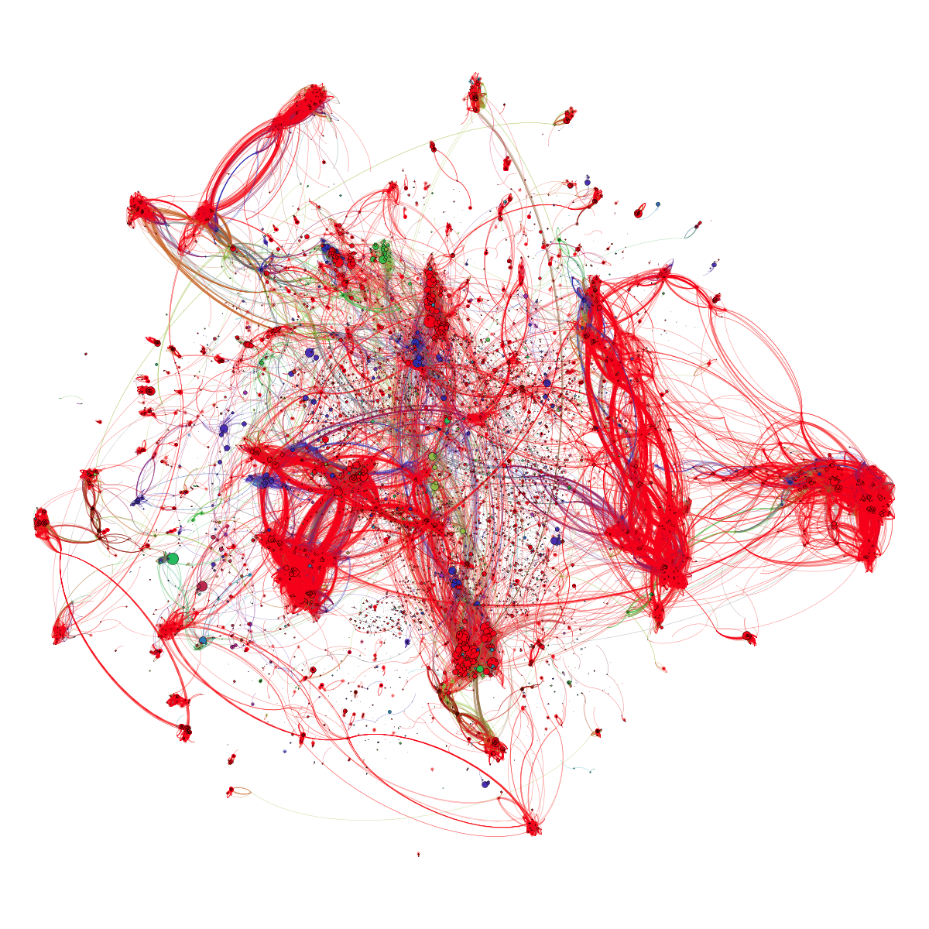

Slide 128
Edit Distance
40,000 implementations of linear regression submitted to Coursera’s ML course

Slide 129
Four Prototypical Trajectories
There must be patterns!

Slide 130
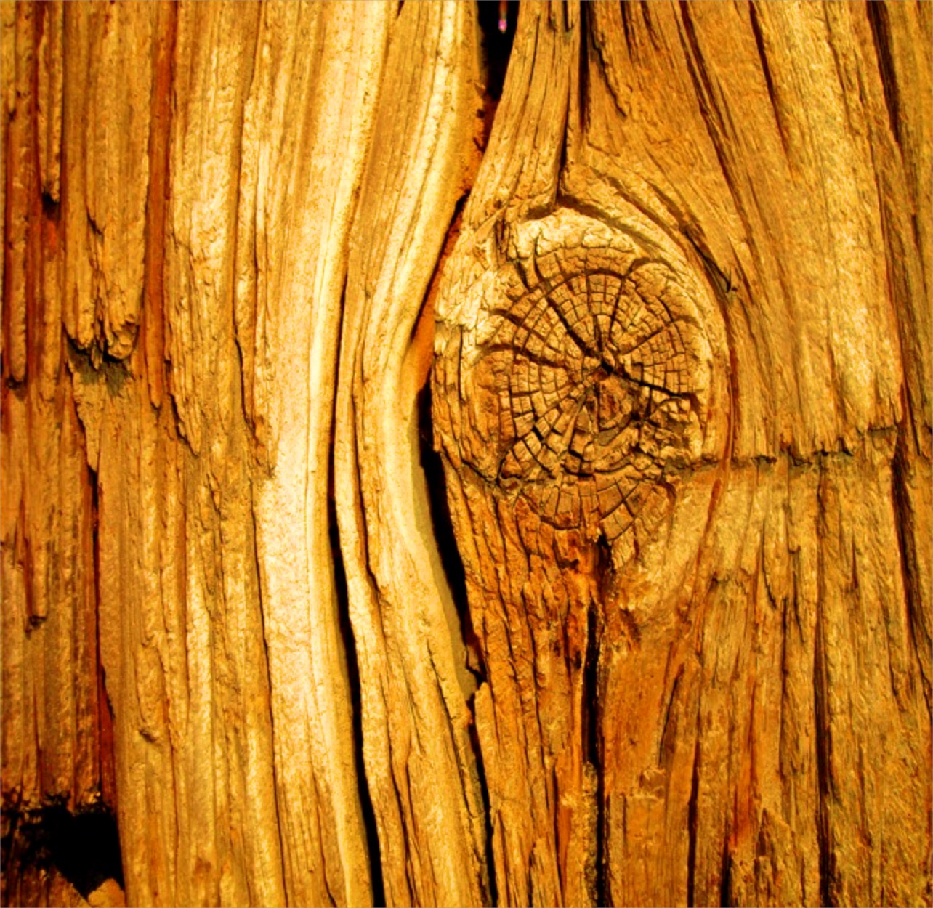

Phrases and Contexts

Slide 131



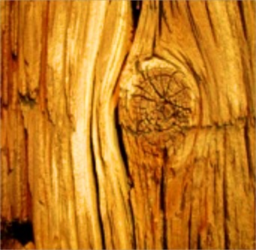
Phrases and Context Search

Slide 132
Efficient Way To Build Tables

Slide 133
{m}
m
rows (X)
rows (y)
size (X, 1)
length (y)
size (y, 1)
length (x (:, 1))
length (X)
size (X) (1)
{alphaOverM}
alpha / {m}
1 * alpha / {m}
alpha .* 1 / {m}
1 / {m} * alpha
alpha .* (1 / {m})
alpha ./ {m}
alpha * inv ({m})
alpha * pinv ({m})
1 .* alpha ./ {m}
alpha * (1 ./ {m})
alpha * 1 ./ {m}
alpha * (1 / {m})
.01 / {m}
alpha .* (1 ./ {m})
alpha * {m} ^ -1
{hypothesis}
{residual}
(X * theta)
(X * theta - y)
(theta' * X')'
(theta' * X' - y')'
[X] * theta
({hypothesis} - y)
(X * theta (:))
({hypothesis}' - y’)'
theta(1) + theta (2) * X (:, 2)
[{hypothesis} - y]
…
…
sum(X.*repmat(theta',{m},1), 2)
sum({hypothesis} - y, 2)

Slide 134
Force Multiply Grading
Equivalence classes, 25 marked ASTS
No Equivalence classes, 200 marked ASTs

Slide 135
Reduction in Number of ASTs
1 equivalence class
10 equivalence classes
19 equivalence classes
(Ordered by frequency of AST)

Slide 136
Four Prototypical Trajectories
Pretty good.

Slide 137
Four Prototypical Trajectories
Equivalence is really complex

Slide 138

Our Approach
Program
Raw programs are not amenable to machine learning algorithms

Slide 139
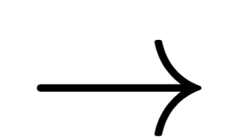
Our Approach
private void placeRow(){
while(isClear()){
putBeeper();
move();
}
putBeeper();
}
…

Slide 140
Previous Framework
Algorithm
Program
Knowledge About Program

Slide 141
Proposed Pipeline
Program
Algorithm
Knowledge About Program

Slide 142
Proposed Pipeline
Program
Program Embedding
…
Supervised Learning
Feedback
…
Notes:
Main contribution is a way to learn a feature representation of programs. What is nice about these features is that you can use them for standard machine learning tasks: like predicting dropout or predicting forum contribution or even predicting feedback.

Slide 143
Desiderata
Four Prototypical Trajectories
Function
Style
Notes:
Desiderata: be predictive of function and style. Lets first focus on function.

Slide 144
Desiderata
Four Prototypical Trajectories
Function
Notes:
Desiderata: be predictive of function and style. Lets first focus on function.

Slide 145

Karel
Salut
Full control flow. No variables
Notes:
He looks like an old machintosh machine.
Hes got legs… one sticks out the back. That’s just the way it is.

Slide 146
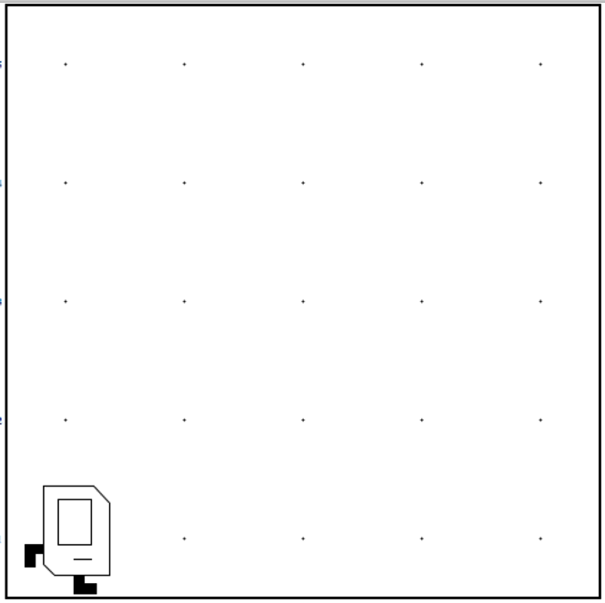
Midpoint
public class Midpoint {
public void run() {
setUp();
while(noBeepersPresent()) {
moveToBeeper();
turnAround();
move();
putBeeper();
move();
}
cleanUp();
}
private void setUp() {
putBeeper();
moveToWall();
putBeeper();
turnAround();
move();
}
[more methods defined]
}
Insert a picture of midpoint
1
2
3
4
5

Slide 147
Collect Triples
Precondition
Code
Postcondition
About 5 million triples per assignment
Notes:
We capture functionality using precondition/code/postcondition triples. That is for every precondition what will the postcondition be when we run this particular piece of code. As an aside, these triples are called Hoare triples in literature after Sir Tony hoare.

Slide 148

Collect Triples
Precondition
Code
Postcondition
About 5 million triples per assignment
Notes:
We capture functionality using precondition/code/postcondition triples. That is for every precondition what will the postcondition be when we run this particular piece of code. As an aside, these triples are called Hoare triples in literature after Sir Tony hoare.

Slide 149
Collect Triples
Precondition
putBeeper();
move();
Code
Postcondition
About 5 million triples per assignment
Notes:
We capture functionality using precondition/code/postcondition triples. That is for every precondition what will the postcondition be when we run this particular piece of code. As an aside, these triples are called Hoare triples in literature after Sir Tony hoare.

Slide 150
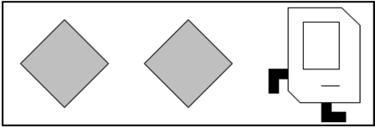
Collect Triples
Precondition
putBeeper();
move();
Code
Postcondition
About 5 million triples per assignment
Notes:
We capture functionality using precondition/code/postcondition triples. That is for every precondition what will the postcondition be when we run this particular piece of code. As an aside, these triples are called Hoare triples in literature after Sir Tony hoare.

Slide 151




A Program is a Mapping
All possible preconditions
…
Notes:
We like to summarize code as a mapping from preconditions to postconditions.

Slide 152
A Program is a Mapping
All possible preconditions
All possible postconditions
…
…
Notes:
We like to summarize code as a mapping from preconditions to postconditions.

Slide 153
A Program is a Mapping
All possible preconditions
All possible postconditions
putBeeper();
move();
…
…
Notes:
We like to summarize code as a mapping from preconditions to postconditions.

Slide 154
A Program is a Mapping
All possible preconditions
All possible postconditions
putBeeper();
move();
…
…
Notes:
We like to summarize code as a mapping from preconditions to postconditions.

Slide 155

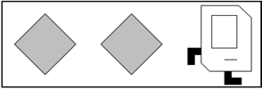
Think of it as a Matrix
0
1
0
0
0
0
0
0
0
1
0
0
0
0
Notes:
We like to summarize code as a mapping from preconditions to postconditions.

Slide 156
Think of it as a Matrix
0
1
0
0
0
0
0
0
0
1
0
0
0
0
0/1 matrix representing: precondition postcondition mapping
=
Ridiculous
Notes:
We like to summarize code as a mapping from preconditions to postconditions.

Slide 157
Think of it as a Matrix
matrix representing: precondition postcondition mapping
=
Precondition
features
Postcondition
features
Notes:
We like to summarize code as a mapping from preconditions to postconditions.

Slide 158


Neural Network
method step() {
putBeeper();
move();
}
Program Matrix
Notes:
These neural networks let us capture complicated non linear features of preconditions and postcondition. This mapping is still a linear mapping. But. It is a mapping from a non-linear feature space to a non-linear features. Thus its capable of capturing complicated, non-linear behavior.

Slide 159
Neural Network
method step() {
putBeeper();
move();
}
Program Matrix
Raw Precondition
Notes:
These neural networks let us capture complicated non linear features of preconditions and postcondition. This mapping is still a linear mapping. But. It is a mapping from a non-linear feature space to a non-linear features. Thus its capable of capturing complicated, non-linear behavior.

Slide 160
Neural Network
method step() {
putBeeper();
move();
}
Program Matrix
Encoder
Raw Precondition
…
Notes:
These neural networks let us capture complicated non linear features of preconditions and postcondition. This mapping is still a linear mapping. But. It is a mapping from a non-linear feature space to a non-linear features. Thus its capable of capturing complicated, non-linear behavior.

Slide 161
Neural Network
method step() {
putBeeper();
move();
}
Multiply Program Matrix
Encoder
Raw Precondition
…
…
Notes:
These neural networks let us capture complicated non linear features of preconditions and postcondition. This mapping is still a linear mapping. But. It is a mapping from a non-linear feature space to a non-linear features. Thus its capable of capturing complicated, non-linear behavior.

Slide 162
Neural Network
method step() {
putBeeper();
move();
}
Multiply Program Matrix
Encoder
Decoder
Raw Precondition
Raw Postcondition
…
…
Notes:
These neural networks let us capture complicated non linear features of preconditions and postcondition. This mapping is still a linear mapping. But. It is a mapping from a non-linear feature space to a non-linear features. Thus its capable of capturing complicated, non-linear behavior.

Slide 163
Neural Network
method step() {
putBeeper();
move();
}
Multiply Program Matrix
Encoder
Decoder
Raw Precondition
Raw Postcondition
…
…
Prediction Loss
Notes:
These neural networks let us capture complicated non linear features of preconditions and postcondition. This mapping is still a linear mapping. But. It is a mapping from a non-linear feature space to a non-linear features. Thus its capable of capturing complicated, non-linear behavior.

Slide 164
Neural Network
method step() {
putBeeper();
move();
}
Can be non-linear
Multiply Program Matrix
Encoder
Decoder
Raw Precondition
Raw Postcondition
…
…
Decoder
Autoencoding Loss
Prediction Loss
Notes:
These neural networks let us capture complicated non linear features of preconditions and postcondition. This mapping is still a linear mapping. But. It is a mapping from a non-linear feature space to a non-linear features. Thus its capable of capturing complicated, non-linear behavior.

Slide 165
Four Prototypical Trajectories
Does it work?

Slide 166
Predicting Output
Model 1
Percent of test set for which we perfectly predict all values in the unit test post-condition.

Slide 167
Predict Output
Common
Edit Distance
Program Embedding
Program embeddings capture functionality of student code!
Code.org
Newspaper
Midpoint

Slide 168
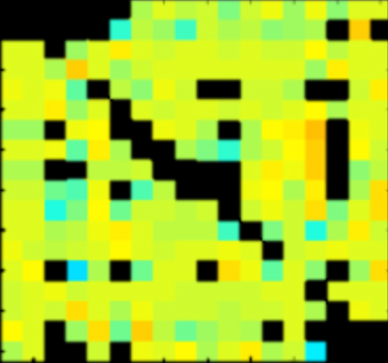
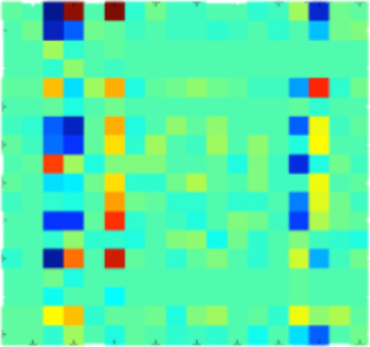
Predict Postconditions
Test | Common | RNN | NPM
Code.org | 58% | 96% | 95%
Stanford 1 | 51 | 94 | 87
Stanford 2 | 42 | 46 | 81
Compose 2 | 39 | 42 | 92
Compose 3 | 39 | 28 | 83
x

Slide 169


Incorporating Style
// User defined method
private void run() {
while(isClear()){
putBeeper();
move();
}
putBeeper();
}
run
while
putBeeper
cond
body
putBeeper
move
Notes:
This is an abstract syntax tree

Slide 170

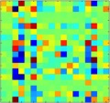
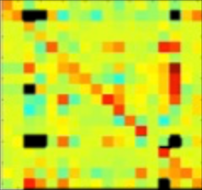
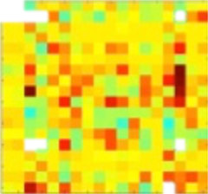
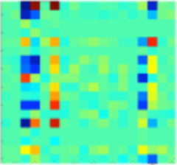
Incorporating Style
// User defined method
private void run() {
while(isClear()){
putBeeper();
move();
}
putBeeper();
}
run
while
putBeeper
cond
body
putBeeper
move
Notes:
We have functionality representations for every single node in the abstract syntax tree. That hierarchy implicitly captures style. We use a Recursive Neural Network incorporate the node type, the functionality and the nodes children. For more details come talk to us at the poster session

Slide 171

Predicting Feedback
It looks like you have a fencepost error!
// User defined method
private void run() {
while(isClear()){
putBeeper();
move();
}
putBeeper();
}
run
while
putBeeper
cond
body
putBeeper
move

Slide 172
Four Prototypical Trajectories
And?

Slide 173


Code.org Feedback
1. Compute Embeddings
2. Annotate 500 Submissions
3. Autonomously Propagate
Deep Learning
Bag of Trees
214×
PC2
PC1
[Piech, Huang, Mehran, Leo. Learning Program Embeddings to Propagate Feedback on Student Code. Under Review ICML]

Slide 174
Midpoint Feedback
45×
Grade a lot of students using a little bit of work.
Room for improvement
Program embeddings
Unit tests
Bag of Trees
20,000

Slide 175


Natural Clusters
Encoder Silhouette: +0.10
Edit distance Silhouette: -0.12
[photo credit: Mike]

Slide 176
Force Multiplication
Feedback Logistic Regression
Expert

Slide 177
Force Multiplication
Feedback Logistic Regression
p
Expert

Slide 178
Force Multiplication
Feedback Logistic Regression
p*
Expert

Slide 179
Force Multiplication
Feedback Logistic Regression
Expert
p*

Slide 180
Force Multiplication
Feedback Logistic Regression
Expert

Slide 181
Force Multiplication
Feedback Logistic Regression
p
Expert

Slide 182
Force Multiplication
Feedback Logistic Regression
p*
Expert

Slide 183
Force Multiplication
Feedback Logistic Regression
Expert
p*

Slide 184
Force Multiplication
Feedback Logistic Regression
p
p*
Expert
Repeat 500 times
p*

Slide 185
Predict Feedback
214×
12×
45×
Purple is baseline
Red is vanilla
Blue is hazelnut

Slide 186
Code Complexity

Slide 187
Four Prototypical Trajectories
Embeddings have lots of potential

Slide 188
Four Prototypical Trajectories
Scratched the surface

Slide 189
Thesis Route
Thesis
Space
Temporal
Curricula
Challenge

Slide 190
Thesis Route
Thesis
Space
Temporal
Curricula
Challenge

Slide 191
Grand Challenge in Education
Clear
Societal Need
Grand Challenge
in Education
Increase
education
productivity
Autonomously support teachers. Can we
understand individual learning and provide
quality feedback for students as they work
on assignments?
MOOC
assignments
Neural
networks
New
Datasets of
Learning
New Machine
Learning
Education debt > Consumer debt

Slide 192
Progress
Understanding Curriculum Navigation
Understanding Problem
Navigation
Understanding Solution
Space
Peer
Grading
Correct/
Incorrect
Maze
Programs
Control Flow Programs
General Programs

Slide 193
Progress
Understanding Curriculum Navigation
1
Understanding Problem
Navigation
2
Understanding Solution
Space
3
3
3
Peer
Grading
Correct/
Incorrect
Maze
Programs
Control Flow Programs
General Programs

Slide 194


Data and Code are Public

Slide 195
Where next?

Slide 196


Slide 197


Deep Q Learner

Slide 198




How it Works
Last 4 frames (s)
Q(s, a)
Neural Net

Slide 199
How it Works
Last 4 frames (s)
Q(s, a)
Neural Net
Eg the utility of each action

Slide 200

How it Works
Last 4 frames (s)
Q(s, a)
Neural Net
Eg the utility of each action
The loss that is propagated is based on Bellman:

Slide 201

A Better Game

Slide 202
Tutor Game
Student Simulator

Slide 203

Tutor Game
Student
Student Simulator
Attempted a Question

Slide 204

Tutor Game
Student
Updated
Student
Student Simulator
Answered the question incorrectly
Attempted a Question

Slide 205
Tutor Game
Student Simulator

Slide 206

Tutor Game
Student
Student Simulator
Is given a hint

Slide 207
Tutor Game
Student
Student Simulator
Updated
Student
Is given a hint

Slide 208
Tutor Game
Hierarchy of concepts
Student Simulator
Students has “ability” for each concept
Each question corresponds to one concept
Each hint corresponds to one concept
Etc…

Slide 209
Deep Tutor
y
h
x

Slide 210
Deep Tutor
y
Q-value
Neural Net
h
x

Slide 211
Deep Tutor
y
Q-value
Neural Net
Back propagate
loss
h
x

Slide 212
Deep Tutor

Slide 213

Unified Model
Neural Net
Q-value
h
encoding(question)
x
encoding(response)

Slide 214
Unified Model
Neural Net
Q-value
h
encoding(question)
x
encoding(response)

Slide 215








The People
Jon Huang
Jascha Sohl-Dickstein
Jon Bassen
Andy Nguyen
Mehran Sahami
Leo Guibas

Slide 216
The End.

Slide 217

Peer Grading Network
The Peer Grading Network for HCI. Node size is relative to the number of students who graded an assignment. One student (and her neighbors) is highlighted in red. Squares represent students who graded her

Slide 218


New Graphical Model
Vanilla Model:
Hazelnut Model:

Slide 219
Improved Accuracy
Before:
After:
Some students were getting very erroneous grades
99% within 10pp
Error is based on ground truth assignments. Results are across all assignments (~10,000 submissions)

Slide 220

Status Network
Line of fairness
Gradee grade (z-score)
Residual
Grader grade (z-score)

Slide 221

Grading Sweet Spot
“sweet spot of grading”: ~ 20 minutes

